Slide 1
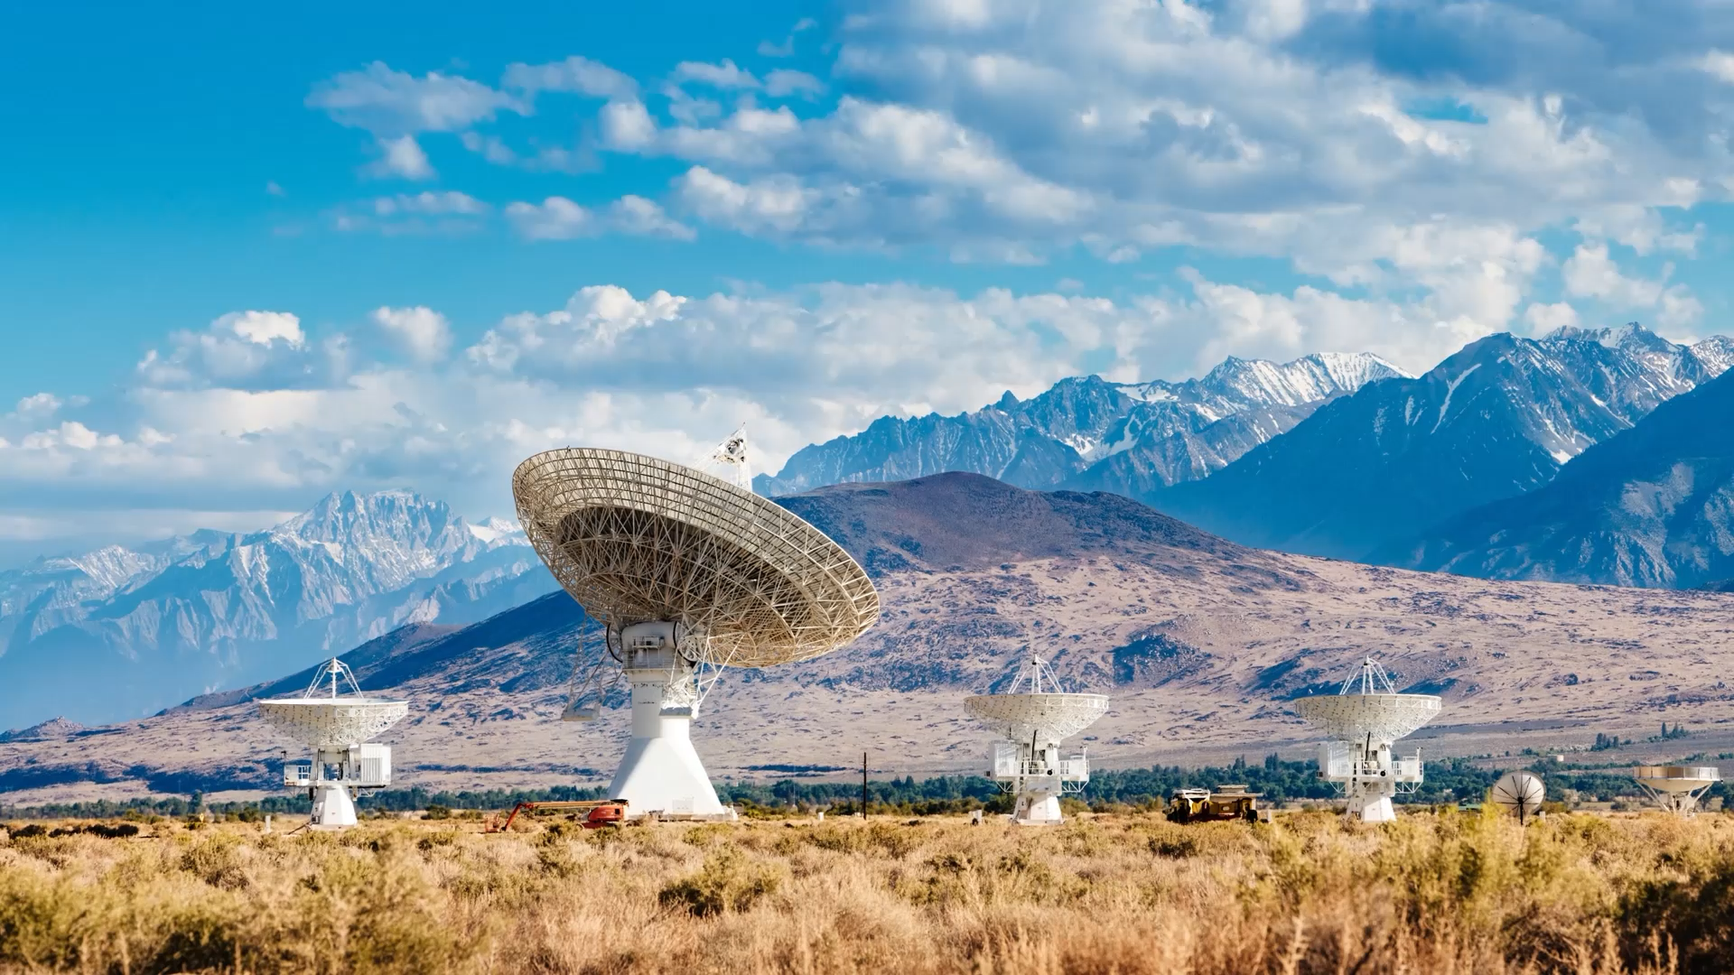
401IT Operating Systems
Week 1 Session 1 – Introduction

Slide 2
Starter
What operating systems do you know about and use?

Slide 3
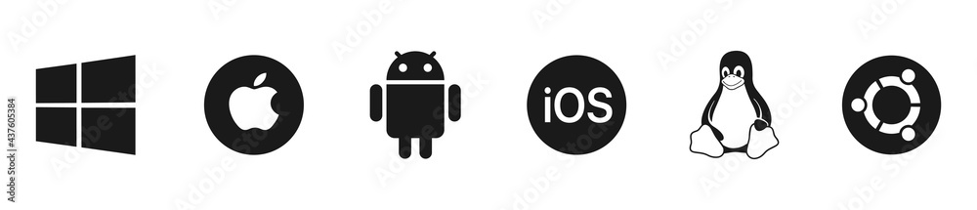
Examples
Notes:
Tux, Ubuntu

Slide 4

Today
Define what an operating system (OS) is and understand its role in computing.
Identify and differentiate between types of operating systems (desktop, server, embedded, real-time, etc.).
Explain key functions and components of an OS (kernel, shell, user interface, file system).

Slide 5
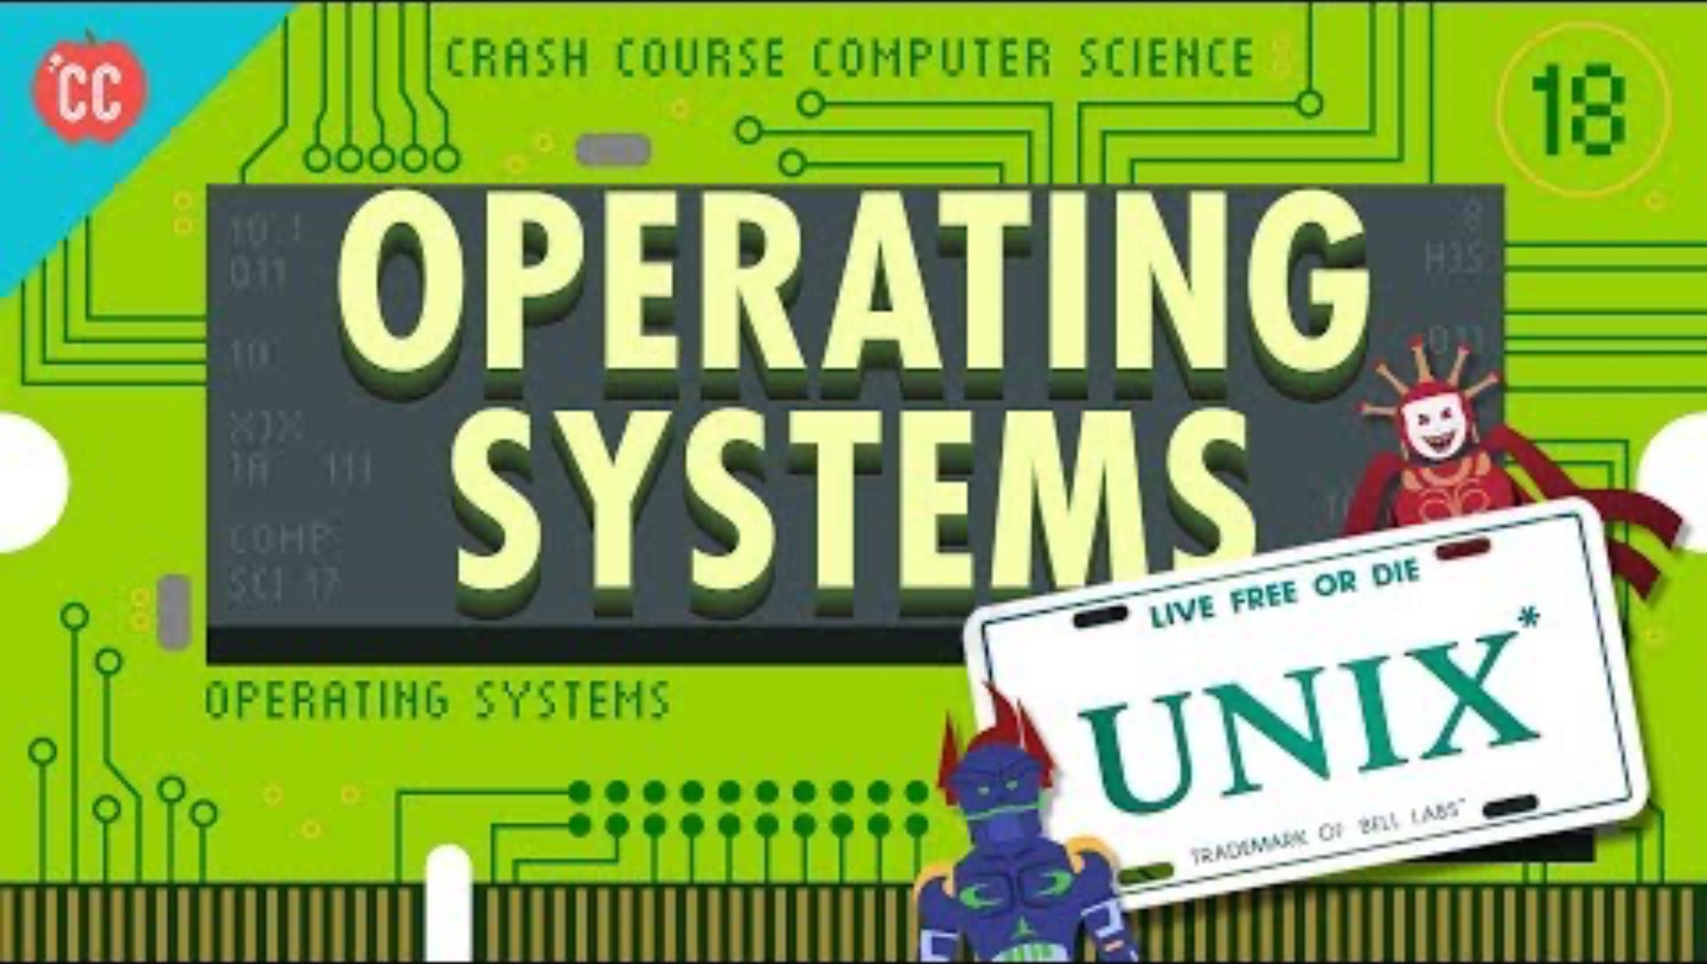
Notes:
https://youtu.be/26QPDBe-NB8?si=kRsPzXj0uVVBSTS2

Slide 6
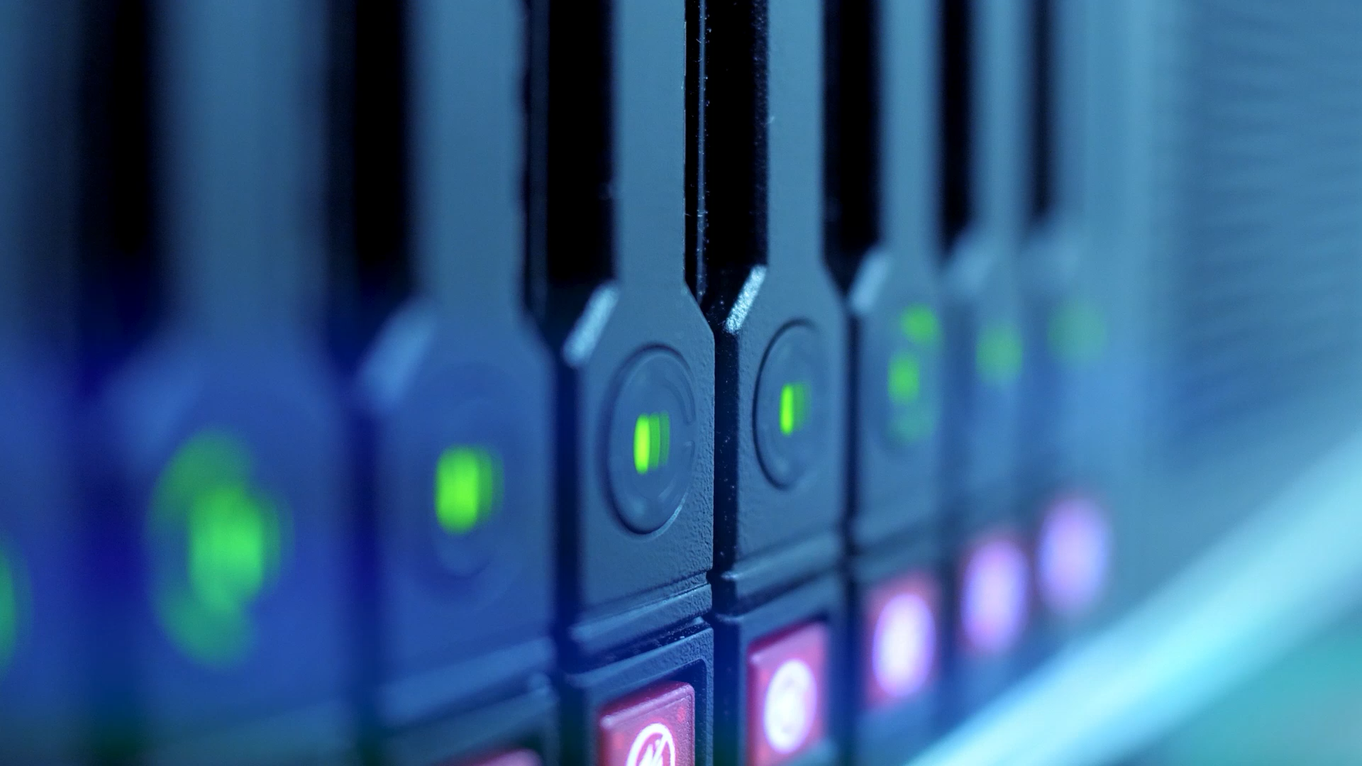
L/O - Define what an operating system (OS) is and understand its role in computing.

Slide 7
Definition
An operating system is a fundamental software layer that manages the hardware and software resources of a computer.
Allows the user to interact with the machine and runs applications.

Slide 8
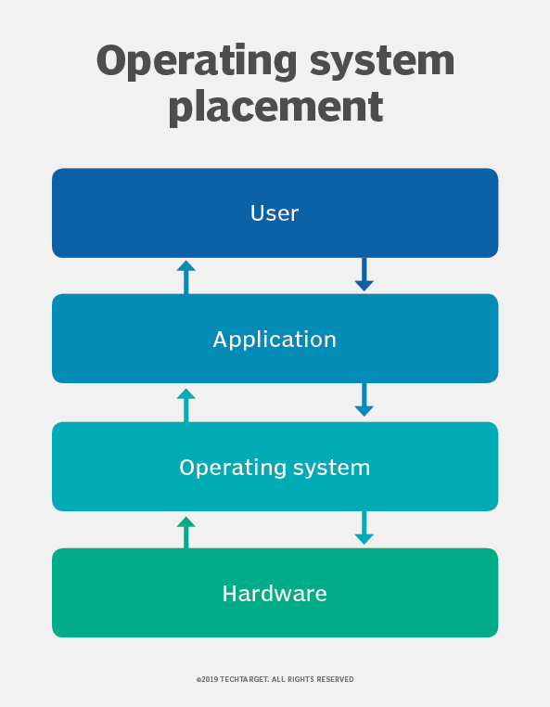
OS in relation to users, applications and hardware

Slide 9

Primary role
Coordinate tasks, manage resources like the CPU, memory, storage and i/o devices whilst providing a stable environment where applications can run without conflicting with each other or hardware resources.

Slide 10
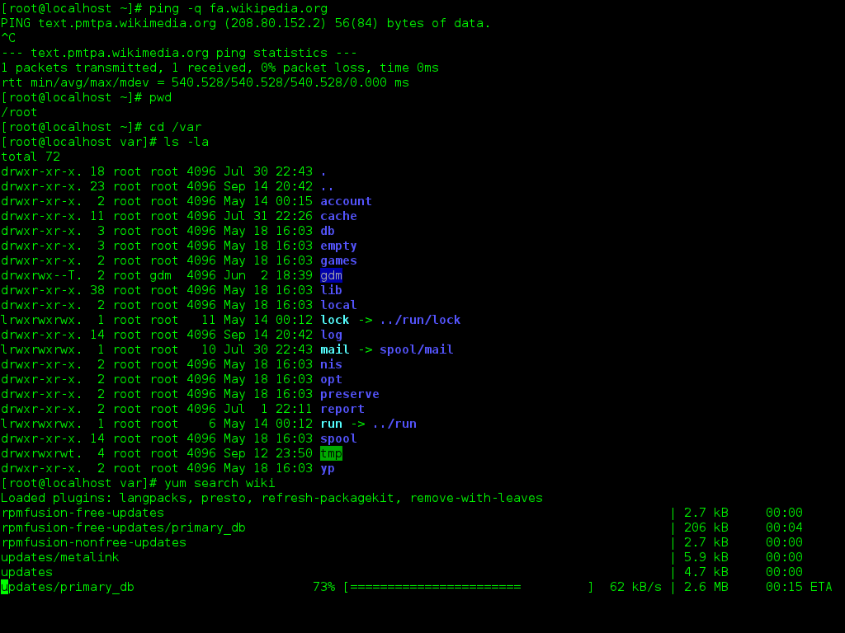
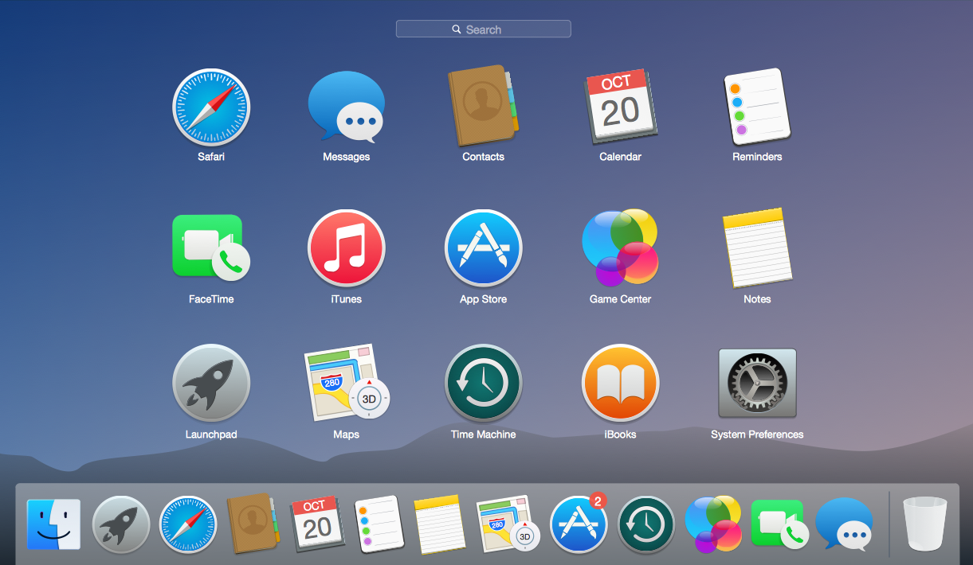
Two Types

Slide 11
Operating System Time Traveller Mission
We’ve been assigned to travel back in time to investigate a specific decade in computing history.
As Time Traveller Tech Teams, it’s our job to:
Define what an Operating System (OS) is
Explain the role of an OS during our assigned decade
Give real examples of popular OSes from that time
Show how those OSes helped people use computers
💡 Our Mission:Each team has a different decade to explore. We’ll research, create, and present our findings in a fun and creative way.

Slide 12
Team 1 – The 1960s
We’re exploring the earliest operating systems. Back when computers filled entire rooms and punch cards were the norm! We’ll look at systems like Batch Processing and CTSS, and explain how they helped mainframes run more than one job.
Team 2 – The 1980s
We’re diving into the decade when personal computers exploded in popularity! Our mission is to explore OSes like MS-DOS, Apple’s System Software, and UNIX, and how they brought computing into homes and businesses.
Team 3 – The 1990s
It’s our turn to showcase the rise of the graphical user interface! We'll look at Windows 95, Mac OS, and the growing popularity of Linux. Our mission is to explain how operating systems became easier to use and supported multitasking.
Team 4 – The 2000s
We’re in the age of stability and security. Let’s investigate how Windows XP, Mac OS X, and Ubuntu made systems more powerful, secure, and user-friendly. What did these OSes let people do that wasn’t possible before?
Team 5 – The 2020s
We are the team of today and the future! We’ll explore how modern OSes like Android, iOS, Windows 11, and ChromeOS power not just computers, but phones, tablets, and smart devices. What role do OSes play in a connected world?

Slide 13
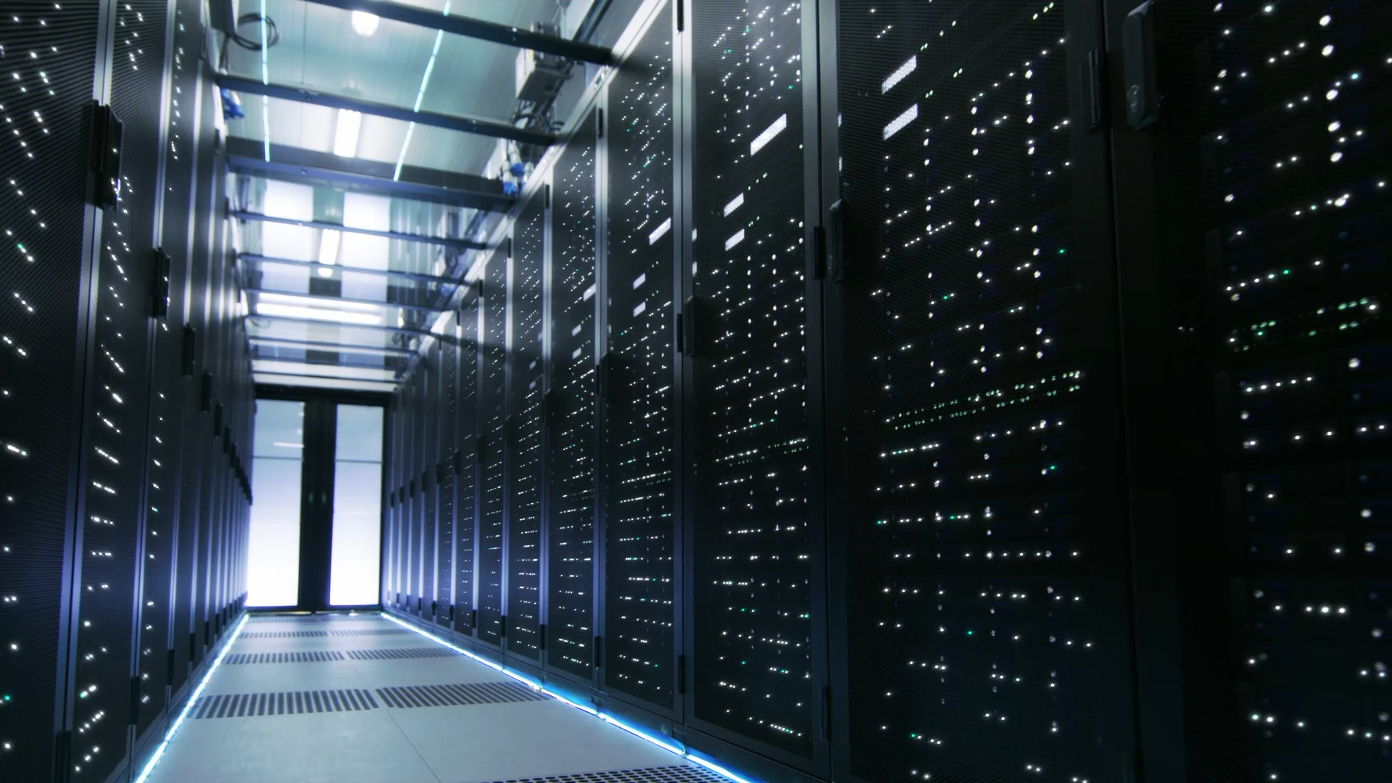
L/O Identify and differentiate between types of operating systems (desktop, server, embedded, real-time, etc.).

Slide 14
OS Type | Description | Examples
Desktop | Designed for everyday use on personal computers. | Windows 10, macOS, Ubuntu
Server | Designed to manage network resources and serve multiple users. | Windows Server, Red Hat Enterprise
Embedded | Built into devices, with limited hardware and specific functions. | Embedded Linux, VxWorks
Real-Time | Designed for systems that require immediate response. | RTOS (e.g., FreeRTOS, QNX)
Mobile | Built for smartphones and tablets. | Android, iOS
Virtualised | Used within virtual machines, not running directly on hardware. | VMware ESXi, VirtualBox

Slide 15

Key Differences
User Count: Desktop (1 user), Server (many users)
Performance Needs: Real-time (strict timing), Embedded (low power)
Flexibility: Mobile & Embedded = limited features
Interface: Desktop = GUI, Embedded/Real-Time = may have no UI at all

Slide 16
“Which OS Am I?” – The Classification Challenge
“I run on traffic light systems. I must respond instantly.”
“I serve web pages to thousands of users across the world.”
“I power a smartwatch that tracks your heart rate.”
“I let you write essays, browse the internet, and play games.”
“I control the software on your smartphone and manage apps.”
Notes:
I run on traffic light systems. I must respond instantly.” → Answer: Real-time OS – because timing is critical.
“I serve web pages to thousands of users across the world.” → Answer: Server OS – designed to manage network resources.
“I power a smartwatch that tracks your heart rate.” → Answer: Embedded OS – designed for a specific device with limited features.
“I let you write essays, browse the internet, and play games.” → Answer: Desktop OS – general purpose and user-friendly.
“I control the software on your smartphone and manage apps.” → Answer: Mobile OS – optimised for touchscreens and app usage.

Slide 17
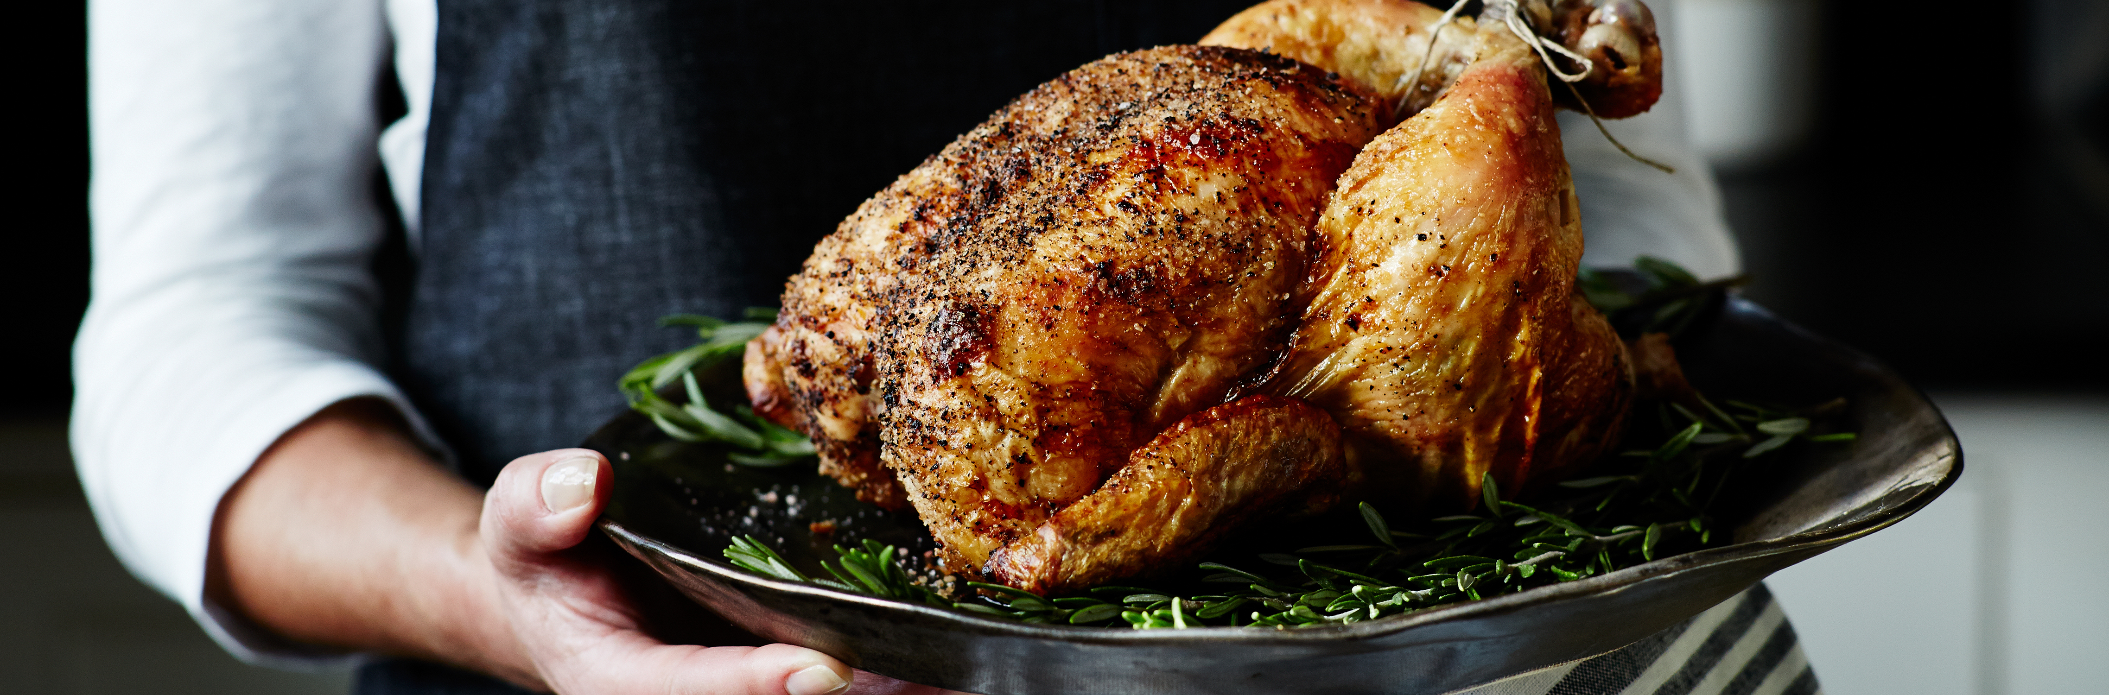
L/O: Explain key functions and components of an OS (kernel, shell, user interface, file system)

Slide 18
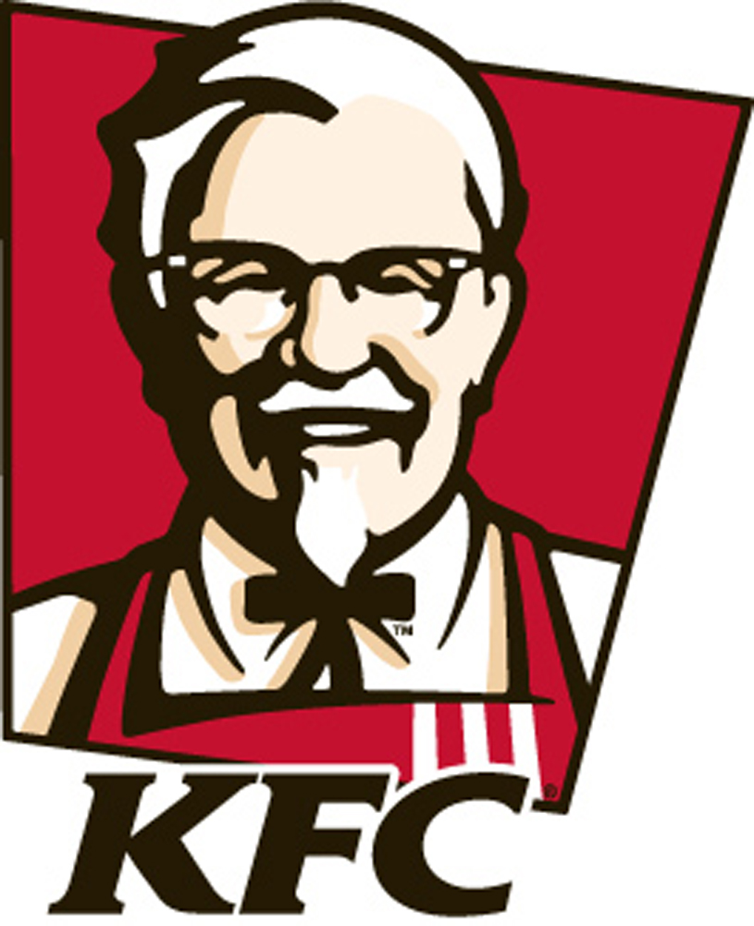


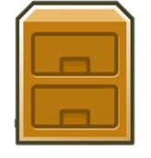
Explain key functions and components of an Operating System (OS), including:
Kernel ( - Colonel Sanders)
Shell ( )
User Interface ( )
File System ( )

Slide 19

The Kernel (The Brain)
The kernel is the core of the OS. It controls everything inside the computer.
Main jobs:
Manages memory
Controls the CPU and scheduling of tasks
Connects software to hardware
Handles input/output (I/O) operations
The head chef does all the real work behind the scenes.

Slide 20
Examples:
Windows NT kernel
Linux kernel
XNU (macOS kernel)

Slide 21

The Shell (The Translator)
The shell is the interface between the user and the kernel.
It accepts user commands and passes them to the kernel to carry out.
Types of Shells:
Command-line interface (CLI): e.g. Bash, PowerShell
Graphical shell: e.g. Windows Explorer, macOS Finder
Analogy: The shell is like a waiter taking your order to the kitchen.

Slide 22
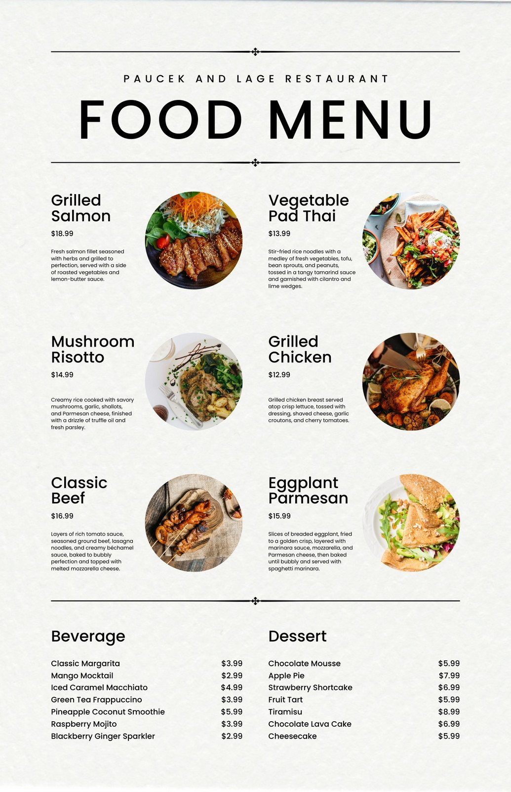
User Interface (The Front-End)
The User Interface (UI) is what the user interacts with directly.
There are two main types:
GUI (Graphical User Interface): e.g. Windows, icons, menus
CLI (Command-Line Interface): text-based commands
Purpose:
Makes using a computer easier
Allows users to open files, launch apps, and manage settings
Analogy – A Menu - You don’t need to know how the kitchen works—you just pick what you want.

Slide 23
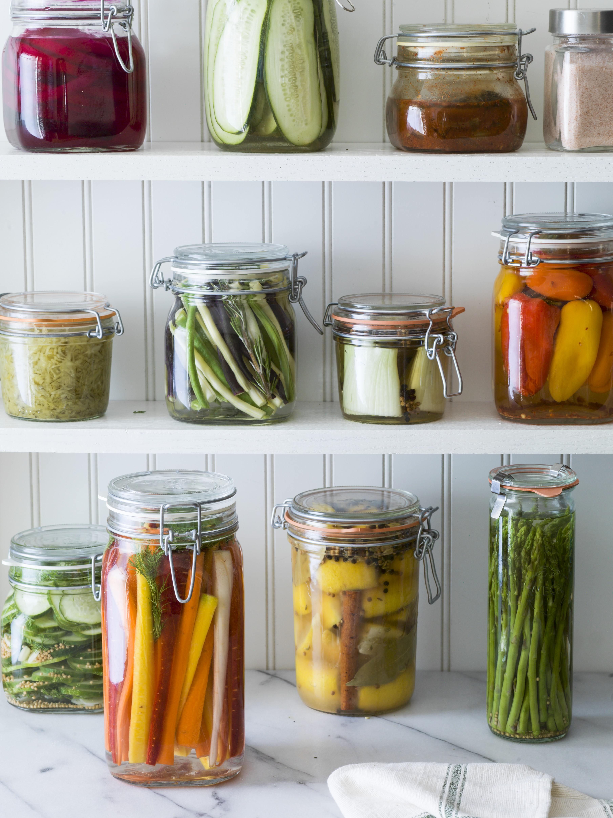
File System (The Organiser)
he File System is how the OS organises and stores data.
What it does:
Manages files and folders
Keeps track of where data is stored
Controls file permissions and access
Common File Systems:
NTFS (Windows)
ext4 (Linux)
APFS (macOS)
FAT32 (used on USB drives)
The store room keeps all the ingredients organised so the chef can find them quickly.
Notes:
NTFS – New Technology File System
Used by Windows operating systems
Supports large files, file permissions, encryption, and journaling
ext4 – Fourth Extended File System
Commonly used in Linux distributions
Reliable, fast, and supports large volumes and files
APFS – Apple File System
Default file system for macOS, iOS, and other Apple devices
Optimised for SSDs, supports encryption, snapshots, and fast performance
FAT32 – File Allocation Table 32
An older, widely compatible file system used on USB drives and SD cards
Compatible across Windows, macOS, Linux, cameras, and consoles
Has file size limits (max 4GB per file)

Slide 24

How They Work Together
Example: Opening a file
You click the file (User Interface)
The shell passes the request to the kernel
The kernel uses the file system to locate the file
The file opens and is displayed to the user
Summary:
Kernel = Controls the machine
Shell = Communicates with the kernel
UI = Lets you interact
File System = Stores and retrieves data

Slide 25
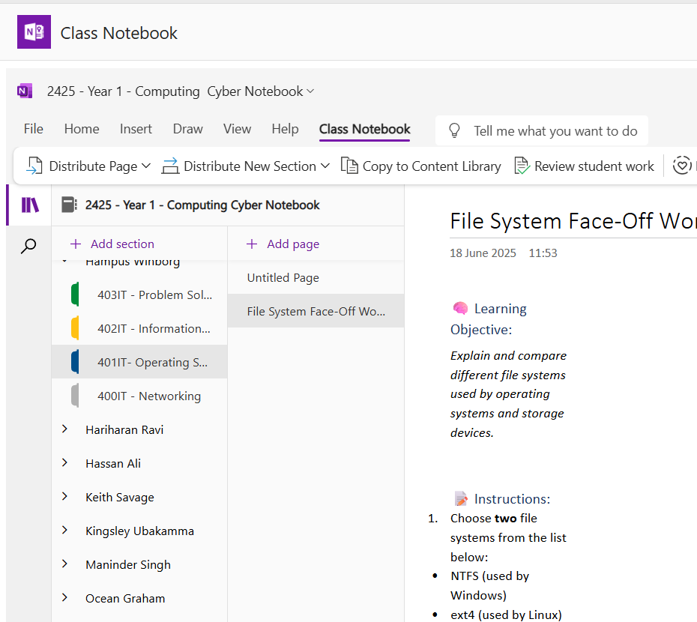
Class Notebook Task

Slide 26
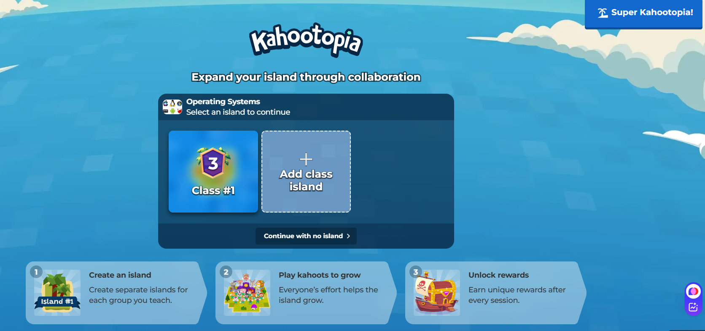
Notes:
https://create.kahoot.it/my-library/kahoots/8719497c-837c-4516-9b4a-69b637c5853a

Slide 27
Have a go at installing an OS
Install VirtualBox
Download a Windows ISO (image)
Create a virtual machine in VirtualBox and install Windows

